Slide 1
IDS 561 Big Data Analytics: Lecture 8: Query processing using Spark SQL and Dataframes
Prof. Yuheng Hu
University of Illinois at Chicago

Slide 2
Prior Query Processing on Big data
MapReduce
Powerful, low-level, procedural programming interface.
Require manual optimization
Pig, Hive
Take advantage of declarative queries to provide richer automatic optimizations.
Relational approach is insufficient for big data applications
ETL to/from semi-/unstructured data sources (e.g. JSON) requires custom code
Advanced analytics(ML and graph processing) are challenging to express in relational system.
Notes:
In practice, most data pipelines would ideally be expressed with a combination of both relational queries and complex procedural algorithms. Relational and procedural—have remained largely disjoint.

Slide 3
Apache Spark(2010)
General cluster computing system.
One of the most widely-used systems with a “language-integrated” API.
One of the most active open source project for big data processing.
Manipulates(e.g. map, filter, reduce) distributed collections called Resilient Distributed Datasets (RDD).
RDDs are evaluated lazily.
Notes:
Resilient Distributed Datasets (RDD) is a fundamental data structure of Spark. It is an immutable distributed collection of objects. Each dataset in RDD is divided into logical partitions, which may be computed on different nodes of the cluster.

Slide 4
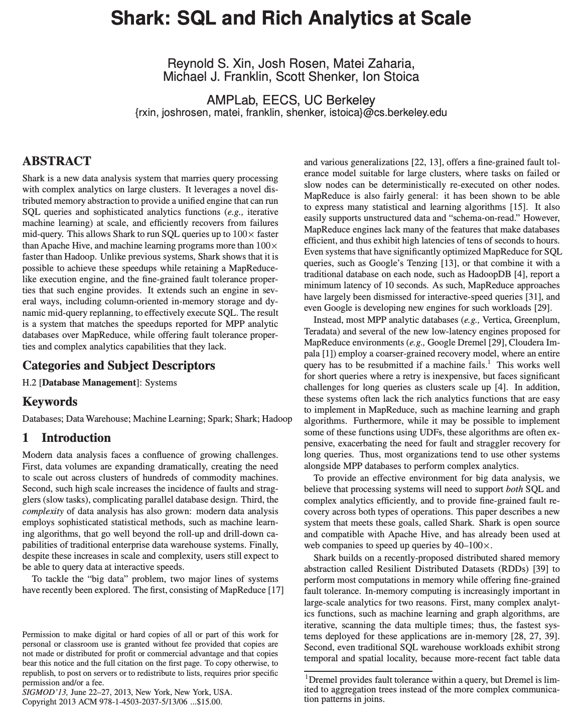
Shark (2013)
First effort to build a relational interface on Spark.
Modified the Apache Hive system with traditional RDBMS optimizations
Shows good performance and opportunities for integration with Spark programs.
Challenges
Only query external data stored in the Hive catalog, and was thus not useful for relational queries on data inside a Spark program(e.g. RDD errors).
Inconvenient and error-prone to work with.
Hive optimizer was tailored for MapReduce and difficult to extend.
Notes:
Hive: data warehouse built on top of Apache Hadoop, providing data summarization, query, and analysis with SQL-like interface to query data stored in various databases and file systems that integrate with Hadoop.

Slide 5
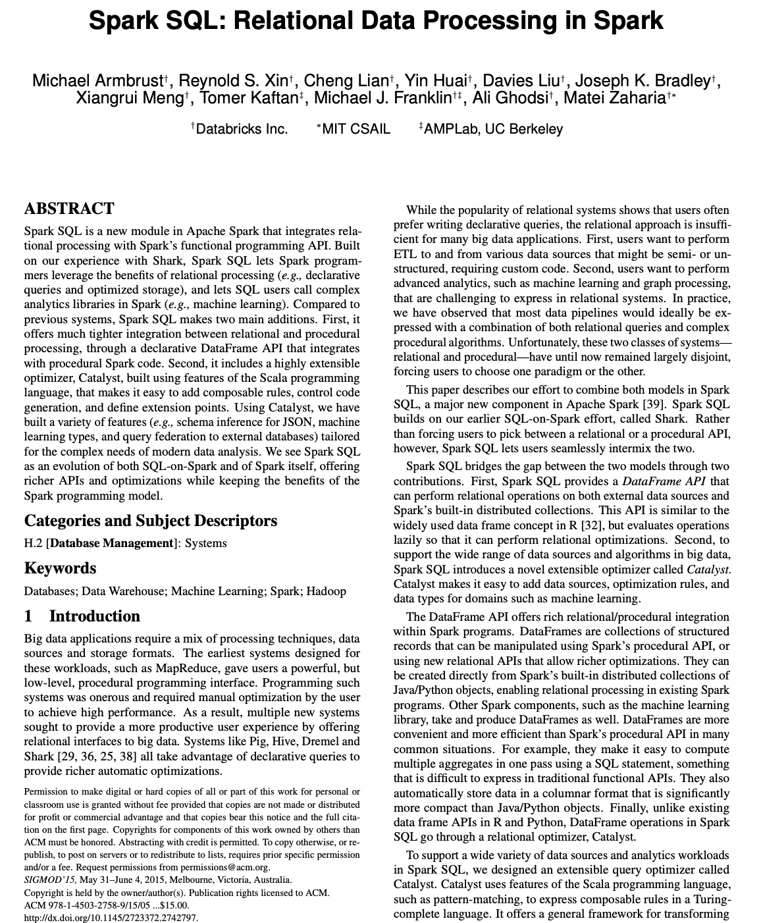
Spark SQL(2015)
A new module in Apache Spark that integrates relational processing with Spark’s functional programming API.
Offers much tighter integration between relational and procedural in processing
Includes a highly extensible optimizer, Catalyst, that makes it easy to add data sources, optimization rules, and data types.

Slide 6
Goals for Spark SQL
Support relational processing both within Spark programs and external data sources using a programmer-friendly API.
Provide high performance using established DBMS techniques.
Easily support new data sources, including semi-structured data and external databases amenable to query federation.
Enable extension with advanced analytics algorithms such as graph processing and machine learning.

Slide 7
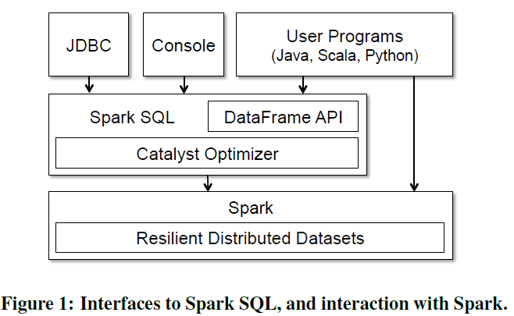
Programming Interface

Slide 8
What are DataFrames?
DataFrames are a recent addition to Spark (early 2015).
The DataFrames API:
is intended to enable wider audiences beyond “Big Data” engineers to leverage the power of distributed processing
is inspired by data frames in R and Python (Pandas)
designed from the ground-up to support modern big data and data science applications
an extension to the existing RDD API
See databricks.com/blog/2015/02/17/introducing-dataframes-in-spark-for- large-scale-data-science.html
8

Slide 9
What are DataFrames?
DataFrames have the following features:
Ability to scale from kilobytes of data on a single laptop to petabytes on a large cluster
Support for a wide array of data formats and storage systems
State-of-the-art optimization and code generation through the Spark SQL Catalyst optimizer
Seamless integration with all big data tooling and infrastructure via Spark
APIs for Python, Java, Scala, and R
9

Slide 10
What are DataFrames?
For new users familiar with data frames in other programming languages, this API should make them feel at home.
For existing Spark users, the API will make Spark easier to program.
For both sets of users, DataFrames will improve performance through intelligent optimizations and code-generation.
10

Slide 11
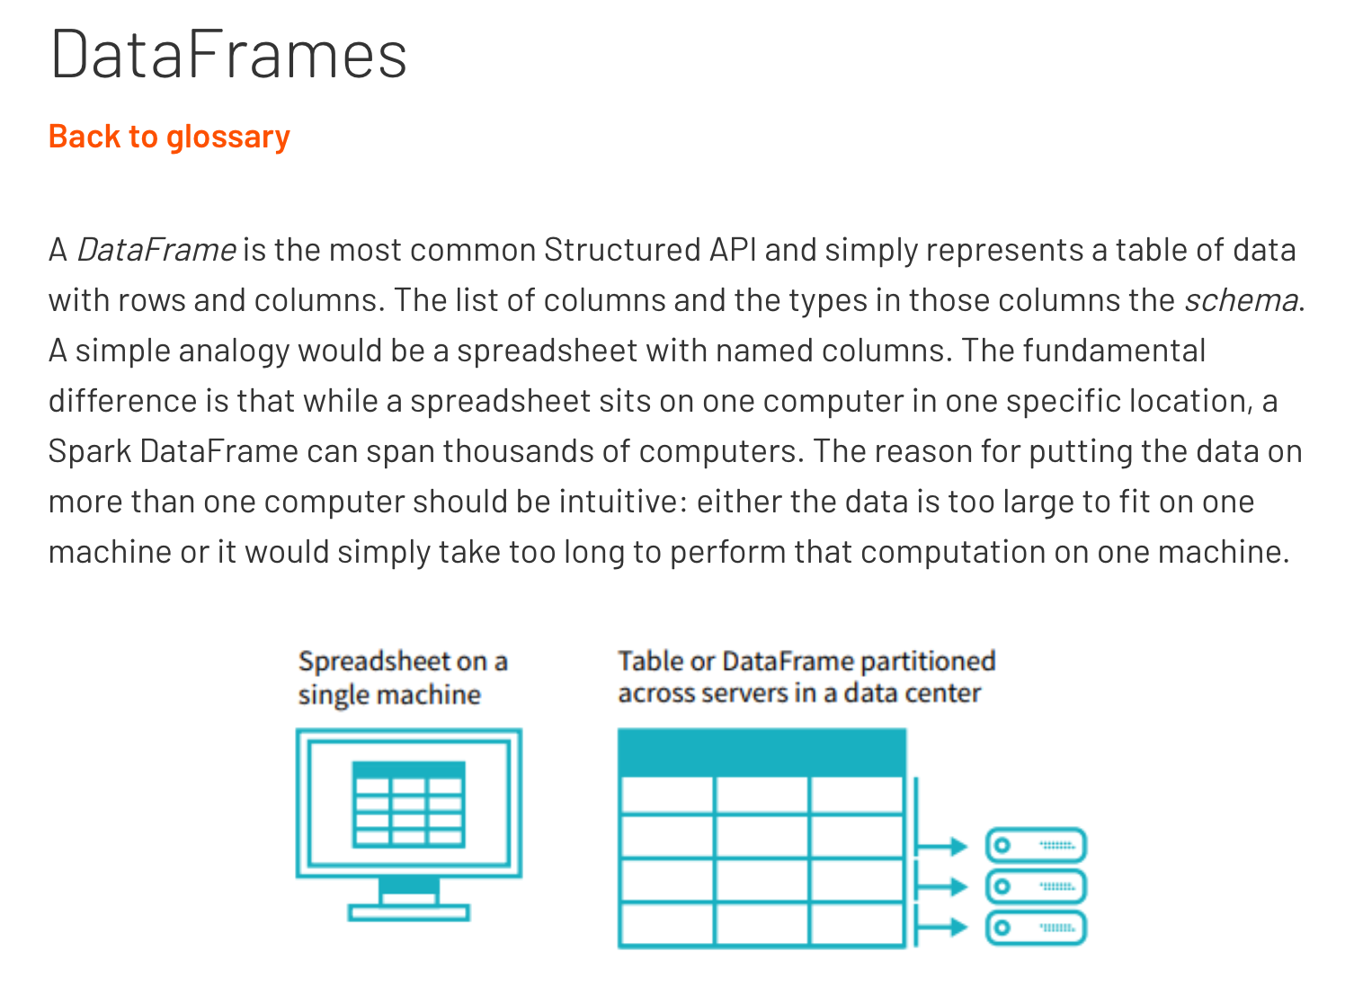
In Spark’s own words
https://databricks.com/glossary/what-are-dataframes

Slide 12







Construct a DataFrame
# Construct a DataFrame from a "users" table in Hive. df = sqlContext.table("users")
# Construct a DataFrame from a log file in S3.
df = sqlContext.load("s3n://someBucket/path/to/data.json", "json")
val people = sqlContext.read.parquet("...")
DataFrame people = sqlContext.read().parquet("...")
12

Slide 13


Use DataFrames
# Create a new DataFrame that contains only "young" young = users.filter(users["age"] < 21)
users
# Alternatively, using a Pandas-­‐like syntax young = users[users.age < 21]
# Increment everybody's age young.select(young["name"],
by 1
young["age"] + 1)
users by gender
# Count the number of young
young.groupBy("gender").count()
# Join young users with another DataFrame, logs young.join(log, logs["userId"] == users["userId"],
"left_outer")
13

Slide 14
DataFrames & Spark SQL
DataFrames are fundamentally tied to Spark SQL.
The DataFrames API provides a programmatic interface—really, a domain-specific language (DSL)—for interacting with your data.
Spark SQL provides a SQL-like interface.
What you can do in Spark SQL, you can do in DataFrames
… and vice versa.
14

Slide 15
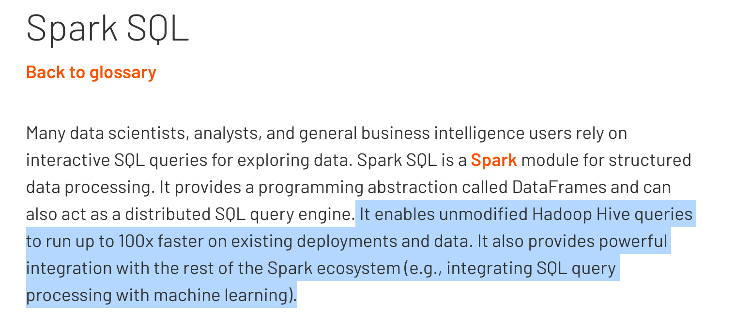
What, exactly, is Spark SQL?
Spark SQL allows you to manipulate distributed data with SQL queries.
https://databricks.com/glossary/what-is-spark-sql
15

Slide 16
Spark SQL
You issue SQL queries through a SQLContext or
HiveContext, using the sql() method.
The sql() method returns a DataFrame.
You can mix DataFrame methods and SQL queries in the same code.
To use SQL, you must either:
query a persisted Hive table, or
make a tablealias for a DataFrame, using
registerTempTable()
16

Slide 17
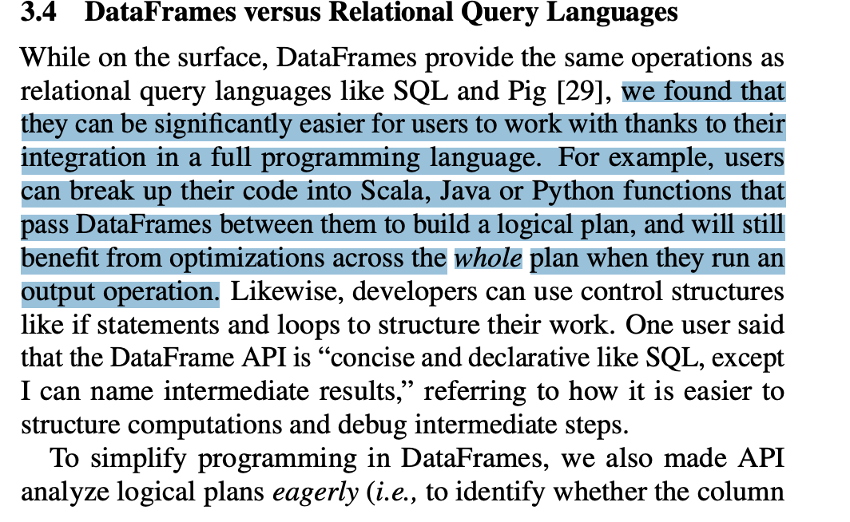
Dataframe vs. Spark SQL
Main two difference processing style
Think about running SQL queries vs. manipulation in Excel
From Spark SQL paper

Slide 18
Transformations, Actions, Laziness
DataFrames are lazy [recall]. Transformations contribute to the query plan, but they don't execute anything.
Actions cause the execution of the query.
Transformation examples
filter
select
drop
intersect
join
Action examples
count
collect
show
head
take
18

Slide 19
Transformations, Actions, Laziness
Actions cause the execution of the query.
What, exactly does "execution of the query" mean? It means:
Spark initiates a distributed read of the data source
The data flows through the transformations (the RDDs resulting from the Catalyst query plan)
The result of the action is pulled back into the driver JVM.
19

Slide 20
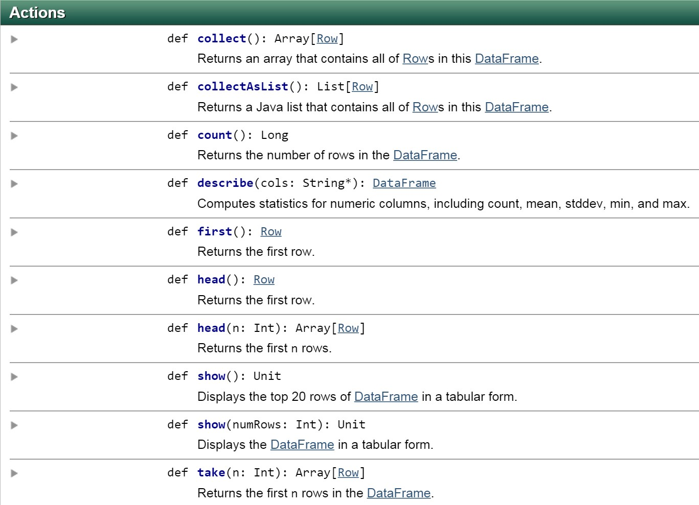

All Actions on a DataFrame
20

Slide 21
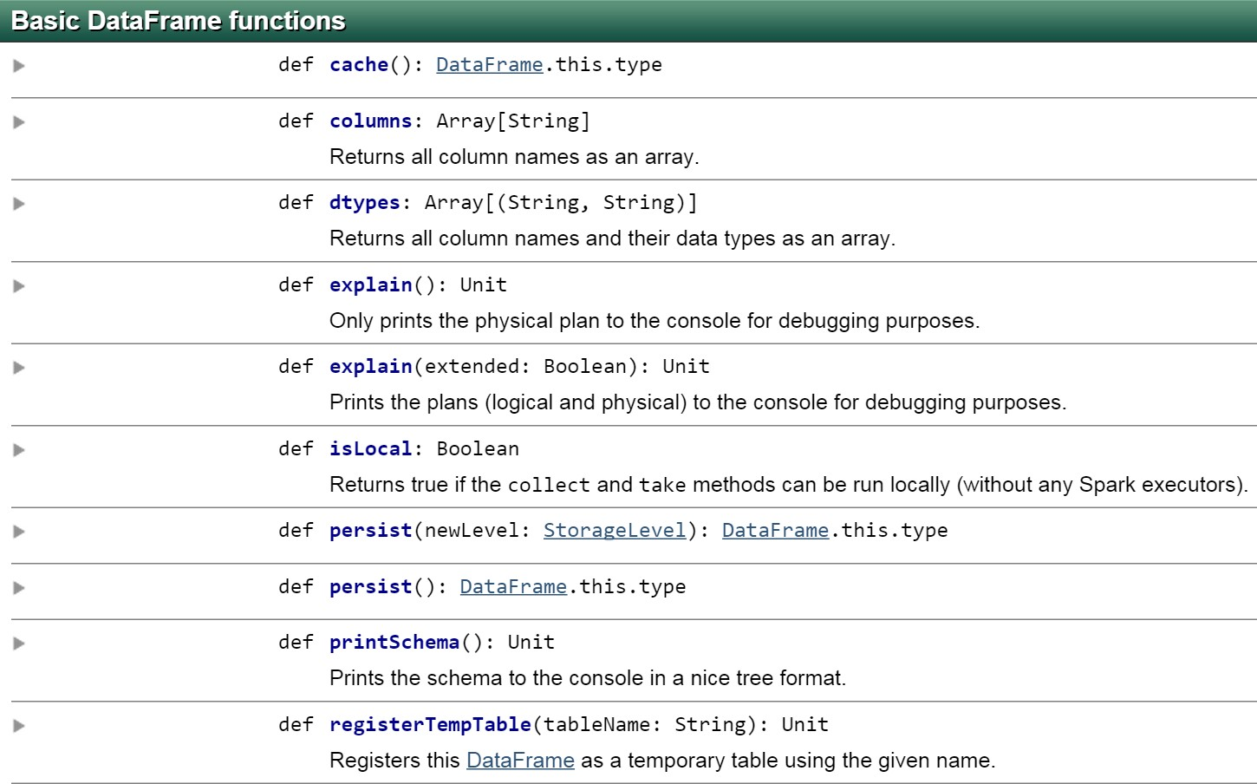
21

Slide 22
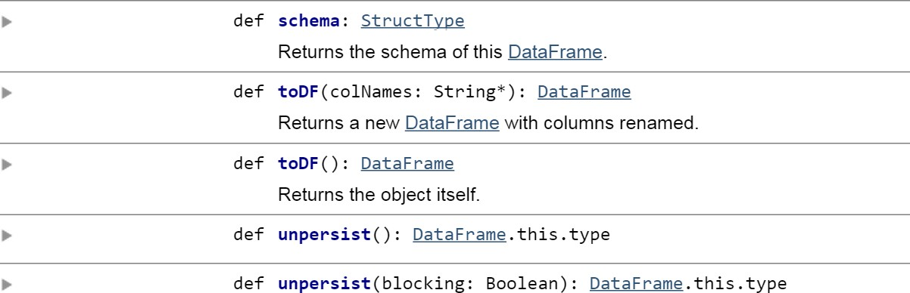
22

Slide 23
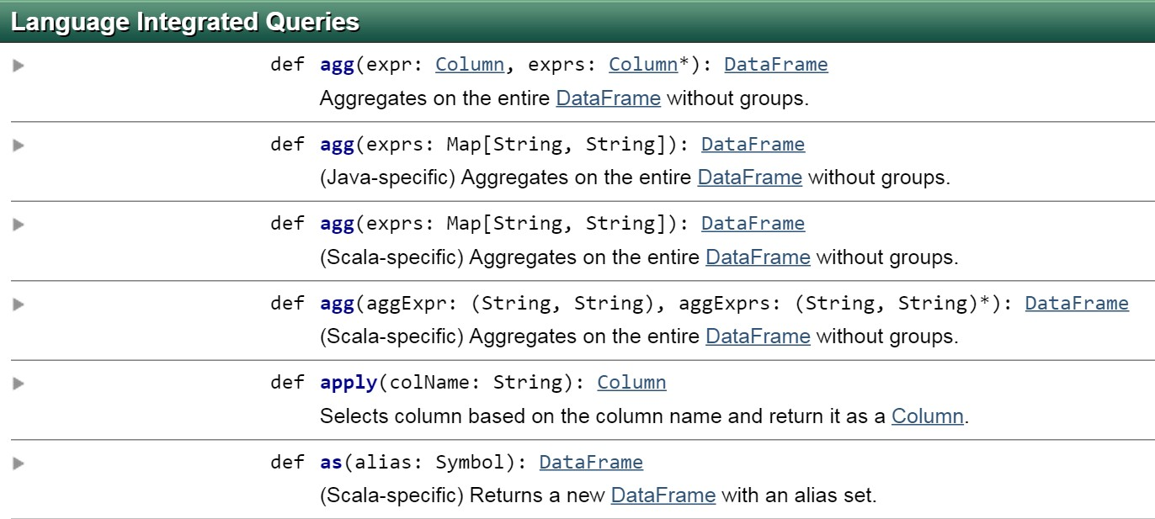
https://spark.apache.org/docs/latest/api/scala/index.html#org.apache.spark.sql.DataFrame
23

Slide 24

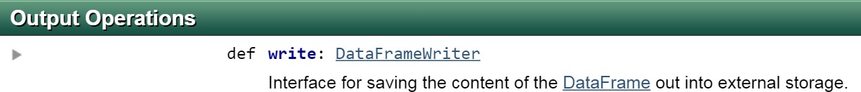
24

Slide 25
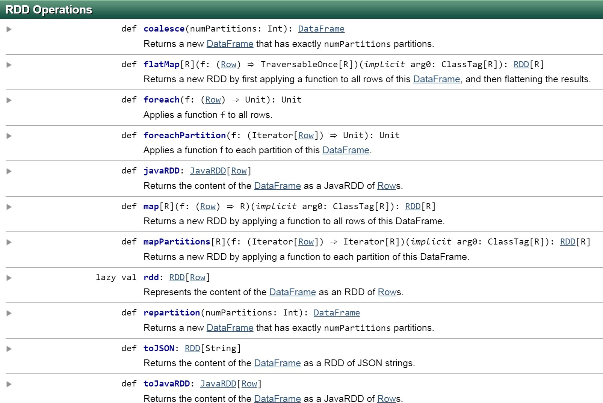
25

Slide 26
DataFrames & Resilient Distributed Datasets (RDDs)
DataFrames are built on top of the Spark RDD API.
This means you can use normal RDD operations on DataFrames.
However, stick with the DataFrame API, wherever possible.
Using RDD operations will often give you back an RDD, not a DataFrame.
The DataFrame API is likely to be more efficient, because it can optimize the underlying operations with Catalyst.
26

Slide 27
DataFrames can be significantly faster than RDDs. And they perform the same, regardless of language.
DataFrame SQL
DataFrame R DataFrame Python DataFrame Scala RDD Python
RDD Scala
0 2 4 6 8
Time to aggregate 10 million integer pairs (in seconds)
10
33

Slide 28
Plan Optimization & Execution
Represented internally as a “logical plan”
Execution is lazy, allowing it to be optimized by Catalyst
34

Slide 29
Plan Optimization & Execution
Analysis
Logical Optimization
Physical Planning
Code Generation
SQL AST
Cost Model
RDDs
Unresolved
Logical Plan
Optimized Logical Plan
Physical Plans
Selected Physical Plan
DataFrame
Logical Plan
Catalog
DataFrames and SQL share the same optimization/execution pipeline
35

Slide 30











Plan Optimization & Execution
joined = users.join(events, users.id == events.uid) filtered = joined.filter(events.date >= ”2015-01-01”)
logical plan
physical plan
filter
join
this join is expensive →→
join
scan (users)
filter
scan (users)
scan (events)
scan (events)
36

Slide 31
Plan Optimization: "Intelligent" Data Sources
The Data Sources API can automatically prune columns and push filters to the source
Parquet: skip irrelevant columns and blocks of data; turn string comparison into integer comparisons for dictionary encoded data
JDBC: Rewrite queries to push predicates down
37

Slide 32



Plan Optimization: "Intelligent" Data Sources
joined = users.join(events, users.id == events.uid) filtered = joined.filter(events.date > ”2015-01-01”)
logical plan
optimized plan
optimized plan
with intelligent data sources
filter
join
join
join
scan (users)
filter
scan (users)
filter scan
(events)
scan (users)
scan (events)
scan (events)
filter done by data source (e.g., RDBMS via JDBC)
38

Slide 33
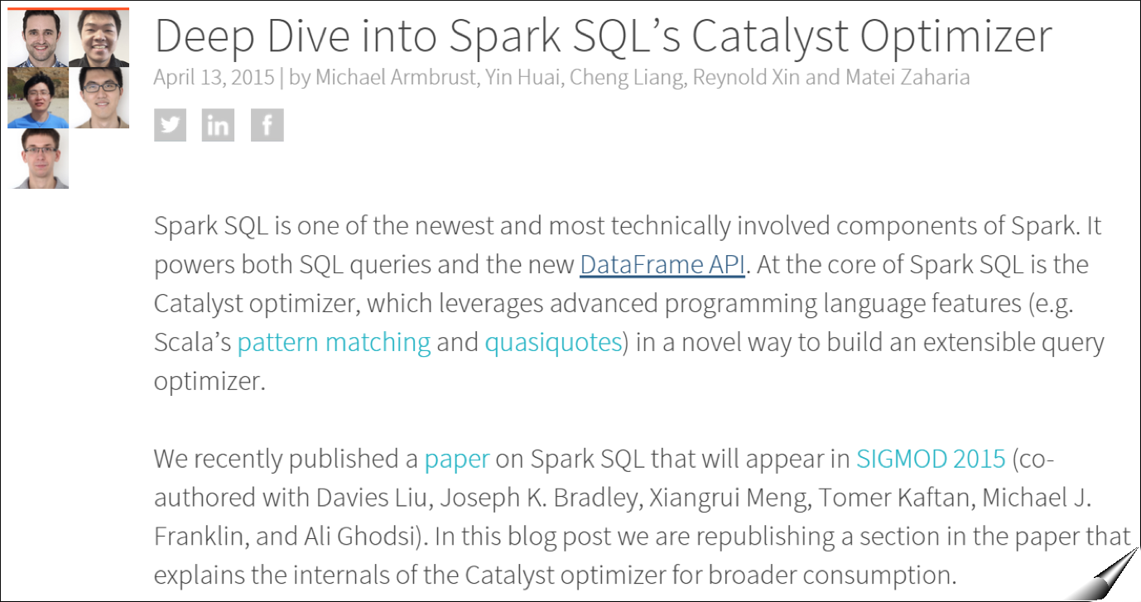
Catalyst Internals
39
https://databricks.com/blog/2015/04/13/deep-­‐dive-­‐into-­‐spark-­‐sqls-­‐catalyst-­‐optimizer.html

Slide 34
Creating a DataFrame
You create a DataFrame with a SQLContext
object (or one of its descendants)
In the Spark Scala shell (spark-shell) or pyspark, you have a SQLContext available automatically, as sqlContext.
In an application, you can easily create one yourself, from a SparkContext.
The DataFrame data source API is consistent, across data formats.
“Opening” a data source works pretty much the same way, no matter what.

Slide 35



Creating a DataFrame in Scala
import org.apache.spark.{SparkConf, SparkContext}
import org.apache.spark.sql.SQLContext
val conf = new SparkConf().setAppName(appName).
setMaster(master)
// Returns existing SparkContext, if there is one;
// otherwise, creates a new one from the config.
val sc = SparkContext.getOrCreate(conf)
// Ditto.
val sqlContext = SQLContext.getOrCreate(sc)
val df = val df2 =
sqlContext.read.parquet("/path/to/data.parquet") sqlContext.read.json("/path/to/data.json")

Slide 36


Creating a DataFrame in Python
from pyspark import SparkContext, SparkConf
conf = SparkConf().setAppName(appName).setMaster(master) sc = SparkContext(conf=conf)
sqlContext = SQLContext(sc)
df = sqlContext.read.parquet("/path/to/data.parquet") df2 = sqlContext.read.json("/path/to/data.json")

Slide 37
SQLContext and HiveContext
Our previous examples created a default Spark
SQLContext object.
If you're using a version of Spark that has Hive support, you can also create a HiveContext, which provides additional features, including:
the ability to write queries using the more complete HiveQL parser
access to Hive user-defined functions
the ability to read data from Hive tables.

Slide 38
HiveContext
To use a HiveContext, you do not need to have an existing Hive installation, and all of the data sources available to a SQLContext are still available.
You do, however, need to have a version of Spark that was built with Hive support. That's not the default.
Hive is packaged separately to avoid including all of Hive’s dependencies in the default Spark build.
If these dependenciesare not a problem for your application then using HiveContext is currently recommended.
It's not difficult to build Spark with Hive support.

Slide 39







HiveContext
If your copy of Spark has Hive support, you can create a
HiveContext easily enough:
import org.spark.sql.hive.HiveContext val sqlContext = new HiveContext(sc)
from pyspark.sql import HiveContext
sqlContext = HiveContext(sc)
sqlContext <-­‐ sparkRHive.init(sc)

Slide 40
DataFrames Have Schemas
In the previous example, we created DataFrames from Parquet and JSON data.
A Parquet table has a schema (column names and types) that Spark can use. Parquet also allows Spark to be efficient about how it pares down data.
Spark can infer a Schema from a JSON file.

Slide 41














Data Sources supported by DataFrames
built-in
external
JDBC
{ JSON }
and more …

Slide 42
Schema Inference
What if your data file doesn’t have a schema? (e.g., You’re reading a CSV file or a plain text file.)
You can create an RDD of a particular type and let
Spark infer the schema from that type. We’ll see how to do that in a moment.
You can use the API to specify the schema programmatically.
(It’s better to use a schema-oriented input source if you can, though.)

Slide 43


Schema Inference Example
Suppose you have a (text) file that looks like this:
Erin,Shannon,F,42 Norman,Lockwood,M,81 Miguel,Ruiz,M,64 Rosalita,Ramirez,F,14 Ally,Garcia,F,39 Claire,McBride,F,23 Abigail,Cottrell,F,75 José,Rivera,M,59 Ravi,Dasgupta,M,25
…
The file has no schema, but it’s obvious there is one:
First name: string
Last name: string
Gender: Age:
string
integer
Let’s see how to get Spark to infer the schema.

Slide 44


Schema Inference :: Python
from pyspark.sql import Row
rdd = sc.textFile("people.csv")
Person = Row('first_name', 'last_name', 'gender', 'age')
def line_to_person(line): cells = line.split(",") cells[3] = int(cells[3]) return Person(*cells)
peopleRDD = rdd.map(line_to_person)
df = peopleRDD.toDF()
# DataFrame[first_name: string, last_name: string, gender: string, age: bigint]

Slide 45
Schema Inference
We can also force schema inference without creating our own People type, by using a fixed- length data structure (such as a tuple) and supplying the column names to the toDF() method.

Slide 46


Schema Inference :: Python
Here’s the Python version:
rdd = sc.textFile("people.csv")
def line_to_person(line): cells = line.split(",")
return tuple(cells[0:3] + [int(cells[3])])
peopleRDD = rdd.map(line_to_person)
df = peopleRDD.toDF(("first_name", "last_name",
"gender", "age"))
Again, if you don’t supply the column names, the API defaults to “_1”, “_2”, etc.

Slide 47
Input Formats of Dataframes
The DataFrames API can be extended to understand additional input formats (or, input sources).
For instance, if you’re dealing with CSV files, a very common data file format, you can use the spark-csv package (spark-packages.org/package/databricks/spark- csv)
This package augments the DataFrames API so that it understands CSV files.

Slide 48


A brief look at spark-csv
Let’s assume our data file has a header:
first_name,last_name,gender,age Erin,Shannon,F,42 Norman,Lockwood,M,81 Miguel,Ruiz,M,64 Rosalita,Ramirez,F,14 Ally,Garcia,F,39 Claire,McBride,F,23 Abigail,Cottrell,F,75 José,Rivera,M,59 Ravi,Dasgupta,M,25
…

Slide 49


A brief look at spark-csv
With spark-csv, we can simply create a DataFrame directly from our CSV file.
// Scala
val df = sqlContext.read.format("com.databricks.spark.csv").
option("header", "true"). load("people.csv")
# Python
df = sqlContext.read.format("com.databricks.spark.csv").\
load("people.csv", header="true")

Slide 50


A brief look at spark-csv
spark-csv uses the header to infer the schema, but the column types will always be string.
// df: org.apache.spark.sql.DataFrame = [first_name: string, last_name: string, gender: string, age: string]

Slide 51


A brief look at spark-csv
Here’s the same thing in Python:
from pyspark.sql.types import *
schema = StructType([StructField("firstName", StringType(), False),
StructField("gender", StringType(), False), StructField("age", IntegerType(), False)])
df = sqlContext.read.format("com.databricks.spark.csv").\
schema(schema).\ load("people.csv")

Slide 52
What can I do with a DataFrame?
Once you have a DataFrame, there are a number of operations you can perform.
Let’s look at a few of them.
But, first, let’s talk about columns.

Slide 53
Columns
When we say “column” here, what do we mean?
A DataFrame column is an abstraction. It provides a common column-oriented view of the underlying data, regardless of how the data is really organized.

Slide 54
Columns
Input Source Format | Data Frame Variable Name | Data
JSON | dataFrame1 | [ {"first": "Amy", "last": "Bello", "age": 29 }, {"first": "Ravi", "last": "Agarwal", "age": 33 }, … ]
CSV | dataFrame2 | first,last,age Fred,Hoover,91 Joaquin,Hernandez,24 …
SQL Table | dataFrame3
Let's see how DataFrame columns map onto some common data sources.
first | last | age
Joe | Smith | 42
Jill | Jones | 33

Slide 55
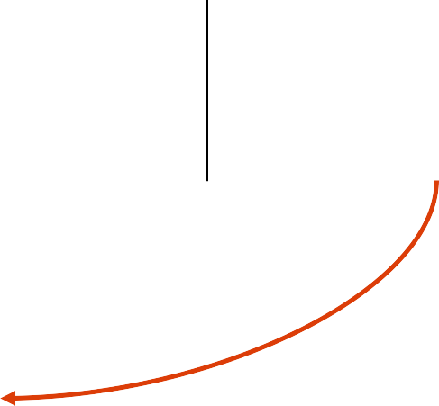











Columns
dataFrame1
column: "first"
Input Source Format | Data Frame Variable Name | Data
JSON | dataFrame1 | [ {"first": "Amy", "last": "Bello", "age": 29 }, {"first": "Ravi", "last": "Agarwal", "age": 33 }, … ]
CSV | dataFrame2 | first,last,age Fred,Hoover,91 Joaquin,Hernandez,24 …
SQL Table | dataFrame3 | first last age Joe Smith 42 Jill Jones 33
dataFrame2
column: "first"
dataFrame3
column: "first"

Slide 56
Columns
When we say “column” here, what do we mean?
Several things:
A place (a cell) for a data value to reside, within a row of data. This cell can have several states:
empty (null)
missing (not there at all)
contains a (typed) value (non-null)
A collection of those cells, from multiple rows
A syntactic construct we can use to specify or target a cell (or collections of cells) in a DataFrame query
How do you specify a column in the DataFrame API?

Slide 57
Columns
Assume we have a DataFrame, df, that reads a data source that has "first", "last", and "age" columns.
Python | Java | Scala | R
df["first"] df.first† | df.col("first") | df("first") $"first"‡ | df$first
†In Python, it’s possible to access a DataFrame’s columns either by attribute (df.age) or by indexing (df['age']). While the former is convenient for interactive data exploration, you should use the index form. It's future proof and won’t break with column names that are also attributes on the DataFrame class.
‡The $ syntax can be ambiguous, if there are multiple DataFrames in the lineage.

Slide 58


printSchema()
You can have Spark tell you what it thinks the data schema is, by calling the printSchema() method. (This is mostly useful in the shell.)
scala> df.printSchema()
root
|-­‐-­‐
|-­‐-­‐
|-­‐-­‐
|-­‐-­‐
firstName: string (nullable lastName: string (nullable
= true)
= true)
gender: string (nullable = true)
age: integer (nullable = false)

Slide 59


printSchema()
> printSchema(df)
root
|-­‐-­‐
|-­‐-­‐
|-­‐-­‐
|-­‐-­‐
firstName: string (nullable lastName: string (nullable
= true)
= true)
gender: string (nullable = true)
age: integer (nullable = false)

Slide 60
show()
You can look at the first n elements in a DataFrame with the show() method. If not specified, n defaults to 20.
This method is an action: It:
reads (or re-reads) the input source
executes the RDD DAG across the cluster
pulls the n elements back to the driver JVM
displays those elements in a tabular form
Note: In R, the function is showDF()

Slide 61


show()
scala> df.show()
+-­‐-­‐-­‐-­‐-­‐-­‐-­‐-­‐-­‐+-­‐-­‐-­‐-­‐-­‐-­‐-­‐-­‐+-­‐-­‐-­‐-­‐-­‐-­‐+-­‐-­‐-­‐+
|firstName|lastName|gender|age|
+-­‐-­‐-­‐-­‐-­‐-­‐-­‐-­‐-­‐+-­‐-­‐-­‐-­‐-­‐-­‐-­‐-­‐+-­‐-­‐-­‐-­‐-­‐-­‐+-­‐-­‐-­‐+
| | Erin| Shannon| | F| | 42|
| | Claire| McBride| | F| | 23|
| | Norman|Lockwood| | M| | 81|
| | Miguel| Ruiz| | M| | 64|
| | Rosalita| Ramirez| | F| | 14|
| | Ally| Garcia| | F| | 39|
| | Abigail|Cottrell| | F| | 75|
| | José| Rivera| | M| | 59|
+-­‐-­‐-­‐-­‐-­‐-­‐-­‐-­‐-­‐+-­‐-­‐-­‐-­‐-­‐-­‐-­‐-­‐+-­‐-­‐-­‐-­‐-­‐-­‐+-­‐-­‐-­‐+

Slide 62


select()
select() is like a SQL SELECT, allowing you to limit the results to specific columns.
scala> df.select($"firstName", $"age").show(5)
+-­‐-­‐-­‐-­‐-­‐-­‐-­‐-­‐-­‐+-­‐-­‐-­‐+
|firstName|age|
| | Erin| | 42|
| | Claire| | 23|
| | Norman| | 81|
| | Miguel| | 64|
| | Rosalita| | 14|
+-­‐-­‐-­‐-­‐-­‐-­‐-­‐-­‐-­‐+-­‐-­‐-­‐+

Slide 63


select()
The DSL also allows you create on-the-fly derived columns.
scala> df.select($"firstName",
$"age",
$"age" >
$"age" +
49,
10).show(5)
+-­‐-­‐-­‐-­‐-­‐-­‐-­‐-­‐-­‐+-­‐-­‐-­‐+-­‐-­‐-­‐-­‐-­‐-­‐-­‐-­‐-­‐-­‐+-­‐-­‐-­‐-­‐-­‐-­‐-­‐-­‐-­‐-­‐+
|firstName|age|(age > 49)|(age + 10)|
+-­‐-­‐-­‐-­‐-­‐-­‐-­‐-­‐-­‐+-­‐-­‐-­‐+-­‐-­‐-­‐-­‐-­‐-­‐-­‐-­‐-­‐-­‐+-­‐-­‐-­‐-­‐-­‐-­‐-­‐-­‐-­‐-­‐+
| | Erin| | 42| | false| | 52|
| | Claire| | 23| | false| | 33|
| | Norman| | 81| | true| | 91|
| | Miguel| | 64| | true| | 74|
| | Rosalita| | 14| | false| | 24|
+-­‐-­‐-­‐-­‐-­‐-­‐-­‐-­‐-­‐+-­‐-­‐-­‐+-­‐-­‐-­‐-­‐-­‐-­‐-­‐-­‐-­‐-­‐+-­‐-­‐-­‐-­‐-­‐-­‐-­‐-­‐-­‐-­‐+

Slide 64


select()
The Python DSL is slightly different.
In[1]: df.select(df['first_name'],
+-­‐-­‐-­‐-­‐-­‐-­‐-­‐-­‐-­‐-­‐+-­‐-­‐-­‐+-­‐-­‐-­‐-­‐-­‐-­‐-­‐-­‐-­‐-­‐+
|first_name|age|(age > 49)|
+-­‐-­‐-­‐-­‐-­‐-­‐-­‐-­‐-­‐-­‐+-­‐-­‐-­‐+-­‐-­‐-­‐-­‐-­‐-­‐-­‐-­‐-­‐-­‐+
df['age'], df['age'] >
49).show(5)
| | Erin| | 42| | false|
| | Claire| | 23| | false|
| | Norman| | 81| | true|
| | Miguel| | 64| | true|
| | Rosalita| | 14| | false|
+-­‐-­‐-­‐-­‐-­‐-­‐-­‐-­‐-­‐-­‐+-­‐-­‐-­‐+-­‐-­‐-­‐-­‐-­‐-­‐-­‐-­‐-­‐-­‐+

Slide 65



select()
And, of course, you can also use SQL. (This is the Python API, but you issue SQL the same way in Scala and Java.)
In[1]: df.registerTempTable("names")
In[2]: sqlContext.sql("SELECT
show(5)
+-­‐-­‐-­‐-­‐-­‐-­‐-­‐-­‐-­‐-­‐+-­‐-­‐-­‐+-­‐-­‐-­‐-­‐-­‐+
|first_name|age| _c2|
+-­‐-­‐-­‐-­‐-­‐-­‐-­‐-­‐-­‐-­‐+-­‐-­‐-­‐+-­‐-­‐-­‐-­‐-­‐+
first_name, age, age > 49 FROM
names").\
| | Erin| | 42|false|
| | Claire| | 23|false|
| | Norman| | 81| true|
| | Miguel| | 64| true|
| | Rosalita| | 14|false|
+-­‐-­‐-­‐-­‐-­‐-­‐-­‐-­‐-­‐-­‐+-­‐-­‐-­‐+-­‐-­‐-­‐-­‐-­‐+

Slide 66


filter()
The filter() method allows you to filter rows out of your results.
scala> df.filter($"age" > 49).select($"firstName", $"age").show()
+-­‐-­‐-­‐-­‐-­‐-­‐-­‐-­‐-­‐+-­‐-­‐-­‐+
|firstName|age|
+-­‐-­‐-­‐-­‐-­‐-­‐-­‐-­‐-­‐+-­‐-­‐-­‐+
| Norman| 81|
| Miguel| 64|
| Abigail| 75|
+-­‐-­‐-­‐-­‐-­‐-­‐-­‐-­‐-­‐+-­‐-­‐-­‐+

Slide 67
filter()
Here’s the Python version.
In[1]: df.filter(df['age’] > 49).\
select(df['first_name'], df['age']).\ show()
+-­‐-­‐-­‐-­‐-­‐-­‐-­‐-­‐-­‐+-­‐-­‐-­‐+
|firstName|age|
+-­‐-­‐-­‐-­‐-­‐-­‐-­‐-­‐-­‐+-­‐-­‐-­‐+
| Norman| 81|
| Miguel| 64|
| Abigail| 75|
+-­‐-­‐-­‐-­‐-­‐-­‐-­‐-­‐-­‐+-­‐-­‐-­‐+

Slide 68
filter()
Here’s the SQL version.
In[1]:
SQLContext.sql("SELECT
"WHERE
first_name, age FROM names " + \ age > 49").show()
+-­‐-­‐-­‐-­‐-­‐-­‐-­‐-­‐-­‐+-­‐-­‐-­‐+
|firstName|age|
+-­‐-­‐-­‐-­‐-­‐-­‐-­‐-­‐-­‐+-­‐-­‐-­‐+
| Norman| 81|
| Miguel| 64|
| Abigail| 75|
+-­‐-­‐-­‐-­‐-­‐-­‐-­‐-­‐-­‐+-­‐-­‐-­‐+

Slide 69


orderBy()
The orderBy() method allows you to sort the results.
scala> df.filter(df("age") > 49).
select(df("firstName"), df("age")).
orderBy(df("age"), df("firstName")). show()
+-­‐-­‐-­‐-­‐-­‐-­‐-­‐-­‐-­‐+-­‐-­‐-­‐+
|firstName|age|
+-­‐-­‐-­‐-­‐-­‐-­‐-­‐-­‐-­‐+-­‐-­‐-­‐+
| Miguel| 64|
| Abigail| 75|
| Norman| 81|
+-­‐-­‐-­‐-­‐-­‐-­‐-­‐-­‐-­‐+-­‐-­‐-­‐+

Slide 70



orderBy()
It’s easy to reverse the sort order.
scala> df.filter($"age" > 49).
select($"firstName", $"age"). orderBy($"age".desc, $"firstName"). show()
+-­‐-­‐-­‐-­‐-­‐-­‐-­‐-­‐-­‐+-­‐-­‐-­‐+
|firstName|age|
+-­‐-­‐-­‐-­‐-­‐-­‐-­‐-­‐-­‐+-­‐-­‐-­‐+
| Norman| 81|
| Abigail| 75|
| Miguel| 64|
+-­‐-­‐-­‐-­‐-­‐-­‐-­‐-­‐-­‐+-­‐-­‐-­‐+

Slide 71

orderBy()
And, in Python:
In [1]: df.filter(df['age'] > 49).\
select(df['first_name'], df['age']).\
orderBy(df['age'].desc(), df['first_name']).show()
+-­‐-­‐-­‐-­‐-­‐-­‐-­‐-­‐-­‐+-­‐-­‐-­‐+
|first_name|age|
+-­‐-­‐-­‐-­‐-­‐-­‐-­‐-­‐-­‐+-­‐-­‐-­‐+
| Norman| 81|
| Abigail| 75|
| Miguel| 64|
+-­‐-­‐-­‐-­‐-­‐-­‐-­‐-­‐-­‐+-­‐-­‐-­‐+

Slide 72
orderBy()
In SQL, it's pretty normal looking:
scala> sqlContext.SQL("SELECT first_name, age FROM names " + "WHERE age > 49 ORDER BY age DESC, first_name").show()
+-­‐-­‐-­‐-­‐-­‐-­‐-­‐-­‐-­‐+-­‐-­‐-­‐+
|first_name|age|
+-­‐-­‐-­‐-­‐-­‐-­‐-­‐-­‐-­‐+-­‐-­‐-­‐+
| Norman| 81|
| Abigail| 75|
| Miguel| 64|
+-­‐-­‐-­‐-­‐-­‐-­‐-­‐-­‐-­‐+-­‐-­‐-­‐+

Slide 73


groupBy()
Often used with count(), groupBy() groups data items by a specific column value.
In [5]: df.groupBy("age").count().show()
+-­‐-­‐-­‐+-­‐-­‐-­‐-­‐-­‐+
|age|count|
+-­‐-­‐-­‐+-­‐-­‐-­‐-­‐-­‐+
| | 39| | 1|
| | 42| | 2|
| | 64| | 1|
| | 75| | 1|
| | 81| | 1|
| | 14| | 1|
| | 23| | 2|
+-­‐-­‐-­‐+-­‐-­‐-­‐-­‐-­‐+
This is Python. Scala and Java are similar.

Slide 74


groupBy()
And SQL, of course, isn't surprising:
scala> sqlContext.sql("SELECT
age, count(age) BY age")
FROM
names " +
|
+-­‐-­‐-­‐+-­‐-­‐-­‐-­‐-­‐+
|age|count|
+-­‐-­‐-­‐+-­‐-­‐-­‐-­‐-­‐+
"GROUP
| | 39| | 1|
| | 42| | 2|
| | 64| | 1|
| | 75| | 1|
| | 81| | 1|
| | 14| | 1|
| | 23| | 2|
+-­‐-­‐-­‐+-­‐-­‐-­‐-­‐-­‐+

Slide 75


as() or alias()
as() or alias() allows you to rename a column. It’s especially useful with generated columns.
In [7]: df.select(df['first_name'],\
df['age'],\
(df['age']
+-­‐-­‐-­‐-­‐-­‐-­‐-­‐-­‐-­‐-­‐+-­‐-­‐-­‐+-­‐-­‐-­‐-­‐-­‐+
|first_name|age|young|
+-­‐-­‐-­‐-­‐-­‐-­‐-­‐-­‐-­‐-­‐+-­‐-­‐-­‐+-­‐-­‐-­‐-­‐-­‐+
< 30).alias('young')).show(5)
| | Erin| | 42|false|
| | Claire| | 23| true|
| | Norman| | 81|false|
| | Miguel| | 64|false|
| | Rosalita| | 14| true|
+-­‐-­‐-­‐-­‐-­‐-­‐-­‐-­‐-­‐-­‐+-­‐-­‐-­‐+-­‐-­‐-­‐-­‐-­‐+
Note: In Python, you must use alias, because as is a keyword.

Slide 76


as() or alias()
Here is it in Scala.
scala>
df.select($"firstName", show()
$"age",
($"age"
< 30).as("young")).
+-­‐-­‐-­‐-­‐-­‐-­‐-­‐-­‐-­‐-­‐+-­‐-­‐-­‐+-­‐-­‐-­‐-­‐-­‐+
|first_name|age|young|
+-­‐-­‐-­‐-­‐-­‐-­‐-­‐-­‐-­‐-­‐+-­‐-­‐-­‐+-­‐-­‐-­‐-­‐-­‐+
| | Erin| | 42|false|
| | Claire| | 23| true|
| | Norman| | 81|false|
| | Miguel| | 64|false|
| | Rosalita| | 14| true|
+-­‐-­‐-­‐-­‐-­‐-­‐-­‐-­‐-­‐-­‐+-­‐-­‐-­‐+-­‐-­‐-­‐-­‐-­‐+

Slide 77


alias()
Here's R. Only alias() is supported here.
> showDF(select(df, df$firstName, df$age,
+ alias(df$age < 30, "young")))
+-­‐-­‐-­‐-­‐-­‐-­‐-­‐-­‐-­‐-­‐+-­‐-­‐-­‐+-­‐-­‐-­‐-­‐-­‐+
|first_name|age|young|
+-­‐-­‐-­‐-­‐-­‐-­‐-­‐-­‐-­‐-­‐+-­‐-­‐-­‐+-­‐-­‐-­‐-­‐-­‐+
| | Erin| | 42|false|
| | Claire| | 23| true|
| | Norman| | 81|false|
| | Miguel| | 64|false|
| | Rosalita| | 14| true|
+-­‐-­‐-­‐-­‐-­‐-­‐-­‐-­‐-­‐-­‐+-­‐-­‐-­‐+-­‐-­‐-­‐-­‐-­‐+

Slide 78


as()
And, of course, SQL:
scala> sqlContext.sql("SELECT firstName,
age,
age < 30 AS young " +
|
+-­‐-­‐-­‐-­‐-­‐-­‐-­‐-­‐-­‐-­‐+-­‐-­‐-­‐+-­‐-­‐-­‐-­‐-­‐+
|first_name|age|young|
+-­‐-­‐-­‐-­‐-­‐-­‐-­‐-­‐-­‐-­‐+-­‐-­‐-­‐+-­‐-­‐-­‐-­‐-­‐+
"FROM names")
| | Erin| | 42|false|
| | Claire| | 23| true|
| | Norman| | 81|false|
| | Miguel| | 64|false|
| | Rosalita| | 14| true|
+-­‐-­‐-­‐-­‐-­‐-­‐-­‐-­‐-­‐-­‐+-­‐-­‐-­‐+-­‐-­‐-­‐-­‐-­‐+

Slide 79
Other Useful Transformations
Method Description
limit(n)
Limit the results to n rows. limit() is not an action, like show() or the RDD take() method. It returns another DataFrame.
distinct()
Returns a new DataFrame containing only the unique rows from the current DataFrame
drop(column)
Returns a new DataFrame with a column dropped. column is a name or a Column object.
intersect(dataframe)
Intersect one DataFrame with another.
join(dataframe)
Join one DataFrame with another, like a SQL join. We’ll discuss this one more in a minute.
There are loads more of them.

Slide 80


Joins
Let’s assume we have a second file, a JSON file that contains records like this:
[
{
"firstName": "Erin", "lastName": "Shannon",
"medium": "oil on canvas"
},
{
"firstName": "Norman", "lastName": "Lockwood", "medium": "metal (sculpture)"
},
…
]

Slide 81


Joins
We can load that into a second DataFrame and join it with our first one.
In [1]: df2 = sqlContext.read.json("artists.json")
# Schema inferred as DataFrame[firstName: string]
In [2]: df.join(
df2,
df.first_name == df2.firstName
).show()
string, lastName: string, medium:
and df.last_name == df2.lastName
+-­‐-­‐-­‐-­‐-­‐-­‐-­‐-­‐-­‐-­‐+-­‐-­‐-­‐-­‐-­‐-­‐-­‐-­‐-­‐+-­‐-­‐-­‐-­‐-­‐-­‐+-­‐-­‐-­‐+-­‐-­‐-­‐-­‐-­‐-­‐-­‐-­‐-­‐+-­‐-­‐-­‐-­‐-­‐-­‐-­‐-­‐+-­‐-­‐-­‐-­‐-­‐-­‐-­‐-­‐-­‐-­‐-­‐-­‐-­‐-­‐-­‐-­‐-­‐+
|first_name|last_name|gender|age|firstName|lastName| medium|
+-­‐-­‐-­‐-­‐-­‐-­‐-­‐-­‐-­‐-­‐+-­‐-­‐-­‐-­‐-­‐-­‐-­‐-­‐-­‐+-­‐-­‐-­‐-­‐-­‐-­‐+-­‐-­‐-­‐+-­‐-­‐-­‐-­‐-­‐-­‐-­‐-­‐-­‐+-­‐-­‐-­‐-­‐-­‐-­‐-­‐-­‐+-­‐-­‐-­‐-­‐-­‐-­‐-­‐-­‐-­‐-­‐-­‐-­‐-­‐-­‐-­‐-­‐-­‐+
| Norman| Lockwood| M| 81| Norman|Lockwood|metal (sculpture)|
| | Erin| | Shannon| | F| | 42| | Erin| | Shannon| | oil | on canvas|
| | Rosalita| | Ramirez| | F| | 14| | Rosalita| | Ramirez| |  | charcoal|
| | Miguel| | Ruiz| | M| | 64| | Miguel| | Ruiz| | oil | on canvas|

Slide 82


Joins
Let’s make that a little more readable by only selecting some of the columns.
In [3]: df3 = df.join(
df2,
df.first_name == df2.firstName and df.last_name == df2.lastName
)
In [4]: df3.select("first_name", "last_name", "age", "medium").show()
+-­‐-­‐-­‐-­‐-­‐-­‐-­‐-­‐-­‐-­‐+-­‐-­‐-­‐-­‐-­‐-­‐-­‐-­‐-­‐+-­‐-­‐-­‐+-­‐-­‐-­‐-­‐-­‐-­‐-­‐-­‐-­‐-­‐-­‐-­‐-­‐-­‐-­‐-­‐-­‐+
|first_name|last_name|age| medium|
+-­‐-­‐-­‐-­‐-­‐-­‐-­‐-­‐-­‐-­‐+-­‐-­‐-­‐-­‐-­‐-­‐-­‐-­‐-­‐+-­‐-­‐-­‐+-­‐-­‐-­‐-­‐-­‐-­‐-­‐-­‐-­‐-­‐-­‐-­‐-­‐-­‐-­‐-­‐-­‐+
Norman| Lockwood| 81|metal (sculpture)|
|
| Erin|
| Rosalita|
| Miguel|
Shannon| 42| Ramirez| 14| Ruiz| 64|
oil on canvas|
charcoal| oil on canvas|
+-­‐-­‐-­‐-­‐-­‐-­‐-­‐-­‐-­‐-­‐+-­‐-­‐-­‐-­‐-­‐-­‐-­‐-­‐-­‐+-­‐-­‐-­‐+-­‐-­‐-­‐-­‐-­‐-­‐-­‐-­‐-­‐-­‐-­‐-­‐-­‐-­‐-­‐-­‐-­‐+

Slide 83


explode()
[
{"id": 909091,
"father": {
"middleName": "Travis", "birthYear": 1973, "lastName": "Czapski", "firstName": "Marvin", "gender": "M"
},
"mother": {
"middleName": "Maryann", "birthYear": 1973, "lastName": "Czapski", "firstName": "Vashti", "gender": "F"
},
"children": [
{"firstName": "Betsy", "middleName": "Rebecka", "lastName": "Czapski", "birthYear": 2005, "gender": "F"}
]
},
...
]
Suppose you have a JSON file consisting of data about families. The file is an array of JSON objects, as shown here.

Slide 84


explode()
When you load it into a DataFrame, here's what you see:
scala> val df = sqlContext.read.json("/data/families.json")
scala> df.select("id", "father", "mother", "children").show(5)
+-­‐-­‐-­‐-­‐-­‐-­‐+-­‐-­‐-­‐-­‐-­‐-­‐-­‐-­‐-­‐-­‐-­‐-­‐-­‐-­‐-­‐-­‐-­‐-­‐-­‐-­‐+-­‐-­‐-­‐-­‐-­‐-­‐-­‐-­‐-­‐-­‐-­‐-­‐-­‐-­‐-­‐-­‐-­‐-­‐-­‐-­‐+-­‐-­‐-­‐-­‐-­‐-­‐-­‐-­‐-­‐-­‐-­‐-­‐-­‐-­‐-­‐-­‐-­‐-­‐-­‐-­‐+
| id | father | mother | children |
+-­‐-­‐-­‐-­‐-­‐-­‐+-­‐-­‐-­‐-­‐-­‐-­‐-­‐-­‐-­‐-­‐-­‐-­‐-­‐-­‐-­‐-­‐-­‐-­‐-­‐-­‐+-­‐-­‐-­‐-­‐-­‐-­‐-­‐-­‐-­‐-­‐-­‐-­‐-­‐-­‐-­‐-­‐-­‐-­‐-­‐-­‐+-­‐-­‐-­‐-­‐-­‐-­‐-­‐-­‐-­‐-­‐-­‐-­‐-­‐-­‐-­‐-­‐-­‐-­‐-­‐-­‐+
|909091|[1973,Marvin,M,Cz...|[1973,Vashti,F,Cz...|List([2005,Betsy,...|
|909092|[1963,Amado,M,Car...|[1970,Darline,F,C...|List([2005,Harrie...|
|909093|[1975,Parker,M,Di...|[1978,Vesta,F,Din...|List([2006,Bobbi,...|
|909094|[1956,Kasey,M,Hur...|[1960,Isela,F,Hur...|List([2005,Cliffo...|
|909095|[1956,Aaron,M,Met...|[1962,Beth,F,Mete...|List([2001,Angila...|
+-­‐-­‐-­‐-­‐-­‐-­‐+-­‐-­‐-­‐-­‐-­‐-­‐-­‐-­‐-­‐-­‐-­‐-­‐-­‐-­‐-­‐-­‐-­‐-­‐-­‐-­‐+-­‐-­‐-­‐-­‐-­‐-­‐-­‐-­‐-­‐-­‐-­‐-­‐-­‐-­‐-­‐-­‐-­‐-­‐-­‐-­‐+-­‐-­‐-­‐-­‐-­‐-­‐-­‐-­‐-­‐-­‐-­‐-­‐-­‐-­‐-­‐-­‐-­‐-­‐-­‐-­‐+

Slide 85


explode()
The schema is more interesting.
scala> df.printSchema
root
|-­‐-­‐ id: integer (nullable = true)
|-­‐-­‐ father: struct (nullable = true)
| |-­‐-­‐ firstName: string (nullable = true)
| |-­‐-­‐ middleName: string (nullable = true)
| |-­‐-­‐ lastName: string (nullable = true)
| |-­‐-­‐ gender: string (nullable = true)
| |-­‐-­‐ birthYear: integer (nullable = true)
|-­‐-­‐ mother: struct (nullable = true)
| |-­‐-­‐ firstName: string (nullable = true)
| |-­‐-­‐ middleName: string (nullable = true)
| |-­‐-­‐ lastName: string (nullable = true)
| |-­‐-­‐ gender: string (nullable = true)
| |-­‐-­‐ birthYear: integer (nullable = true)
|-­‐-­‐ children: array (nullable = true)
|
|
|
|
|
|
|-­‐-­‐ element: struct (containsNull = true)
|
|
|
|
|
|-­‐-­‐ firstName: string (nullable = true)
|-­‐-­‐ middleName: string (nullable = true)
|-­‐-­‐ lastName: string (nullable = true)
|-­‐-­‐ gender: string (nullable = true)
|-­‐-­‐ birthYear: integer (nullable = true)
110

Slide 86


explode()
In that layout, the data can be difficult to manage. But, we can explode the columns to make them easier to manage. For instance, we can turn a single children value, an array, into multiple values, one per row:
scala> val df2 = df.filter($"id" === 168).
explode[Seq[Person], Person]("children", "child") { v => v.toList }
scala> df2.show()
+-­‐-­‐-­‐+-­‐-­‐-­‐-­‐-­‐-­‐-­‐-­‐-­‐-­‐-­‐-­‐-­‐-­‐-­‐-­‐-­‐-­‐-­‐-­‐+-­‐-­‐-­‐-­‐-­‐-­‐-­‐-­‐-­‐-­‐-­‐-­‐-­‐-­‐-­‐-­‐-­‐-­‐-­‐-­‐+-­‐-­‐-­‐-­‐-­‐-­‐-­‐-­‐-­‐-­‐-­‐-­‐-­‐-­‐-­‐-­‐-­‐-­‐-­‐-­‐+-­‐-­‐-­‐-­‐-­‐-­‐-­‐-­‐-­‐-­‐-­‐-­‐-­‐-­‐-­‐-­‐-­‐-­‐-­‐-­‐+
| id| father| mother| children| child|
+-­‐-­‐-­‐+-­‐-­‐-­‐-­‐-­‐-­‐-­‐-­‐-­‐-­‐-­‐-­‐-­‐-­‐-­‐-­‐-­‐-­‐-­‐-­‐+-­‐-­‐-­‐-­‐-­‐-­‐-­‐-­‐-­‐-­‐-­‐-­‐-­‐-­‐-­‐-­‐-­‐-­‐-­‐-­‐+-­‐-­‐-­‐-­‐-­‐-­‐-­‐-­‐-­‐-­‐-­‐-­‐-­‐-­‐-­‐-­‐-­‐-­‐-­‐-­‐+-­‐-­‐-­‐-­‐-­‐-­‐-­‐-­‐-­‐-­‐-­‐-­‐-­‐-­‐-­‐-­‐-­‐-­‐-­‐-­‐+
|168|[Nicolas,Jorge,Tr...|[Jenette,Elouise,...|ArrayBuffer([Terr...|[Terri,Olene,Traf...|
|168|[Nicolas,Jorge,Tr...|[Jenette,Elouise,...|ArrayBuffer([Terr...|[Bobbie,Lupe,Traf...|
|168|[Nicolas,Jorge,Tr...|[Jenette,Elouise,...|ArrayBuffer([Terr...|[Liana,Ophelia,Tr...|
|168|[Nicolas,Jorge,Tr...|[Jenette,Elouise,...|ArrayBuffer([Terr...|[Pablo,Son,Trafto...|
+-­‐-­‐-­‐+-­‐-­‐-­‐-­‐-­‐-­‐-­‐-­‐-­‐-­‐-­‐-­‐-­‐-­‐-­‐-­‐-­‐-­‐-­‐-­‐+-­‐-­‐-­‐-­‐-­‐-­‐-­‐-­‐-­‐-­‐-­‐-­‐-­‐-­‐-­‐-­‐-­‐-­‐-­‐-­‐+-­‐-­‐-­‐-­‐-­‐-­‐-­‐-­‐-­‐-­‐-­‐-­‐-­‐-­‐-­‐-­‐-­‐-­‐-­‐-­‐+-­‐-­‐-­‐-­‐-­‐-­‐-­‐-­‐-­‐-­‐-­‐-­‐-­‐-­‐-­‐-­‐-­‐-­‐-­‐-­‐+
Note what happened: A single children column value was exploded into multiple values, one per row. The rest of the values in the original row were duplicated in the new rows.

Slide 87


explode()
The resulting DataFrame has one child per row, and it's easier to work with:
scala> df2.select($"father.firstName".as("fatherFirstName"),
$"mother.firstName".as("motherFirstName"),
$"child.firstName".as("childFirstName"),
$"child.middleName".as("childMiddleName")).show()
+-­‐-­‐-­‐-­‐-­‐-­‐-­‐-­‐-­‐-­‐-­‐-­‐-­‐-­‐-­‐+-­‐-­‐-­‐-­‐-­‐-­‐-­‐-­‐-­‐-­‐-­‐-­‐-­‐-­‐-­‐+-­‐-­‐-­‐-­‐-­‐-­‐-­‐-­‐-­‐-­‐-­‐-­‐-­‐-­‐+-­‐-­‐-­‐-­‐-­‐-­‐-­‐-­‐-­‐-­‐-­‐-­‐-­‐-­‐-­‐+
|fatherFirstName|motherFirstName|childFirstName|childMiddleName|
|
|
|
|
Nicolas| Nicolas| Nicolas| Nicolas|
Jenette| Jenette| Jenette| Jenette|
Terri| Bobbie| Liana| Pablo|
Olene| Lupe| Ophelia|
Son|
+-­‐-­‐-­‐-­‐-­‐-­‐-­‐-­‐-­‐-­‐-­‐-­‐-­‐-­‐-­‐+-­‐-­‐-­‐-­‐-­‐-­‐-­‐-­‐-­‐-­‐-­‐-­‐-­‐-­‐-­‐+-­‐-­‐-­‐-­‐-­‐-­‐-­‐-­‐-­‐-­‐-­‐-­‐-­‐-­‐+-­‐-­‐-­‐-­‐-­‐-­‐-­‐-­‐-­‐-­‐-­‐-­‐-­‐-­‐-­‐+

Slide 88


User Defined Functions
Suppose our JSON data file capitalizes the names differently than our first data file. The obvious solution is to force all names to lower case before joining.
Alas, there is no lower() function…
In[6]: df3 = df.join(df2, lower(df.first_name)
lower(df.last_name)
== lower(df2.firstName)
== lower(df2.lastName))
and \
NameError: name 'lower' is not defined

Slide 89


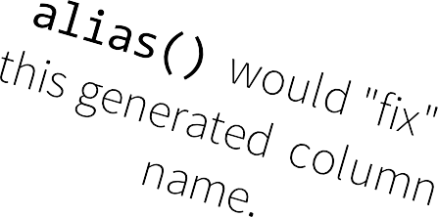
User Defined Functions
However, this deficiency is easily remedied with a user defined function.
In [8]: from pyspark.sql.functions import udf
In [9]: lower = udf(lambda s: s.lower())
In
[10]: df.select(lower(df['firstName'])).show(5)
+-­‐-­‐-­‐-­‐-­‐-­‐-­‐-­‐-­‐-­‐-­‐-­‐-­‐-­‐-­‐-­‐-­‐-­‐-­‐-­‐-­‐-­‐-­‐-­‐-­‐-­‐-­‐-­‐-­‐-­‐+
|PythonUDF#<lambda>(first_name)|
+-­‐-­‐-­‐-­‐-­‐-­‐-­‐-­‐-­‐-­‐-­‐-­‐-­‐-­‐-­‐-­‐-­‐-­‐-­‐-­‐-­‐-­‐-­‐-­‐-­‐-­‐-­‐-­‐-­‐-­‐+
| erin|
| claire|
| norman|
| miguel|
| rosalita|
+-­‐-­‐-­‐-­‐-­‐-­‐-­‐-­‐-­‐-­‐-­‐-­‐-­‐-­‐-­‐-­‐-­‐-­‐-­‐-­‐-­‐-­‐-­‐-­‐-­‐-­‐-­‐-­‐-­‐-­‐+

Slide 90


User Defined Functions
Interestingly enough, lower() does exist in the Scala API. So, let’s invent something that doesn’t:
scala> df.select(double($("total")))
console>:23: error: not found: value double
df.select(double($("total"))).show()
^

Slide 91


User Defined Functions
Again, it’s an easy fix.
scala> val double = sqlContext.udf.register("double",
(i:
org.apache.spark.sql.UserDefinedFunction
Int) => i.toDouble)
=
double:
UserDefinedFunction(<function1>,DoubleType)
scala> df.select(double($("total"))).show(5)
+---------------+
|scalaUDF(total)|
+---------------+
| 7065.0|
| 2604.0|
| 2003.0|
| 1939.0|
| 1746.0|
+---------------+

Slide 92
Writing DataFrames
You can write DataFrames out, as well. When doing ETL, this is a very common requirement.
In most cases, if you can read a data format, you can write that data format, as well.
If you're writing to a text file format (e.g., JSON), you'll typically get multiple output files.

Slide 93



Writing DataFrames
scala> df.write.format("json").save("/path/to/directory")
scala> df.write.format("parquet").save("/path/to/directory")
In [20]: df.write.format("json").save("/path/to/directory")
In [21]: df.write.format("parquet").save("/path/to/directory")
120

Slide 94
Writing DataFrames: Save modes
Save operations can optionally take a SaveMode that specifies how to handle existing data if present.
Scala/Java | Python | Meaning
SaveMode.ErrorIfExists (default) | "error" | If output data or table already exists, an exception is expected to be thrown.
SaveMode.Append | "append" | If output data or table already exists, append contents of the DataFrame to existing data.
SaveMode.Overwrite | "overwrite" | If output data or table already exists, replace existing data with contents of DataFrame.
SaveMode.Ignore | "ignore" | If output data or table already exists, do not write DataFrame at all.

Slide 95

Writing DataFrames: Save modes
Warning: These save modes do not utilize any locking and are not atomic.
Thus, it is not safe to have multiple writers attempting to write to the same location. Additionally, when performing a overwrite, the data will be deleted before writing out the new data.

Slide 96
Writing DataFrames: Hive
When working with a HiveContext, you can save a DataFrame as a persistent table, with the saveAsTable() method.
Unlike registerTempTable(), saveAsTable() materializes the DataFrame (i.e., runs the DAG) and creates a pointer to the data in the Hive metastore.
Persistent tables will exist even after your Spark program has restarted.

Slide 97
Writing Data Frames: Hive
By default, saveAsTable() will create a managed table: the metastore controls the location of the data. Data in a managed table is also deleted automatically when the table is dropped.

Slide 98
Other Hive Table Operations
To create a DataFrame from a persistent Hive table, call the table() method on a SQLContext, passing the table name.
To delete an existing Hive table, just use SQL:
sqlContext.sql("DROP TABLE IF EXISTS tablename")

Slide 99


Explain
You can dump the query plan to standard output, so you can get an idea of how Spark will execute your query.
In[3]: df3 = df.join(df2,
df.first_name == df2.firstName and df.last_name == df2.lastName)
In[4]: df3.explain()
ShuffledHashJoin [last_name#18], [lastName#36], BuildRight Exchange (HashPartitioning 200)
PhysicalRDD [first_name#17,last_name#18,gender#19,age#20L], MapPartitionsRDD[41] at applySchemaToPythonRDD at NativeMethodAccessorImpl.java:-­‐2
Exchange (HashPartitioning 200)
PhysicalRDD [firstName#35,lastName#36,medium#37], MapPartitionsRDD[118] at
executedPlan at NativeMethodAccessorImpl.java:-­‐2

Slide 100


Explain
Pass true to get a more detailed query plan.
scala> df.join(df2, lower(df("firstName")) === lower(df2("firstName"))).explain(true)
== Parsed Logical Plan ==
Join Inner, Some((Lower(firstName#1) = Lower(firstName#13))) Relation[birthDate#0,firstName#1,gender#2,lastName#3,middleName#4,salary#5L,ssn#6] org.apache.spark.sql.json.JSONRelation@7cbb370e
Relation[firstName#13,lastName#14,medium#15] org.apache.spark.sql.json.JSONRelation@e5203d2c
== Analyzed Logical Plan ==
birthDate: string, firstName: string, gender: string, lastName: string, middleName: string, salary: bigint, ssn: string, firstName: string, lastName: string, medium: string
Join Inner, Some((Lower(firstName#1) = Lower(firstName#13))) Relation[birthDate#0,firstName#1,gender#2,lastName#3,middleName#4,salary#5L,ssn#6] org.apache.spark.sql.json.JSONRelation@7cbb370e
Relation[firstName#13,lastName#14,medium#15] org.apache.spark.sql.json.JSONRelation@e5203d2c
== Optimized Logical Plan ==
Join Inner, Some((Lower(firstName#1) = Lower(firstName#13))) Relation[birthDate#0,firstName#1,gender#2,lastName#3,middleName#4,salary#5L,ssn#6] org.apache.spark.sql.json.JSONRelation@7cbb370e
Relation[firstName#13,lastName#14,medium#15] org.apache.spark.sql.json.JSONRelation@e5203d2c
== Physical Plan ==
ShuffledHashJoin [Lower(firstName#1)], [Lower(firstName#13)], BuildRight Exchange (HashPartitioning 200)
PhysicalRDD [birthDate#0,firstName#1,gender#2,lastName#3,middleName#4,salary#5L,ssn#6], MapPartitionsRDD[40] at explain at
<console>:25
Exchange (HashPartitioning 200)
PhysicalRDD [firstName#13,lastName#14,medium#15], MapPartitionsRDD[43] at explain at <console>:25
Code Generation: false
== RDD ==

Slide 101
Machine Learning Integration
Spark 1.2 introduced a new package called spark.ml, which aims to provide a uniform set of high-level APIs that help users create and tune practical machine learning pipelines.
Spark ML standardizes APIs for machine learning algorithms to make it easier to combine multiple algorithms into a single pipeline, or workflow.

Slide 102
Machine Learning Integration
Spark ML uses DataFrames as a dataset which can hold a variety of data types.
For instance, a dataset could have different columns storing text, feature vectors, true labels, and predictions.

Slide 103
ML: Transformer
A Transformer is an algorithm which can transform one DataFrame into another DataFrame.
A Transformer object is an abstraction which includes
feature transformers and learned models.
Technically, a Transformer implements a
transform() method that converts one DataFrame into another, generally by appending one or more columns.

Slide 104
ML: Transformer
A feature transformer might:
take a dataset,
read a column (e.g., text),
convert it into a new column (e.g., feature vectors),
append the new column to the dataset, and
output the updated dataset.

Slide 105
ML: Transformer
A learning model might:
take a dataset,
read the column containing feature vectors,
predict the label for each feature vector,
append the labels as a new column, and
output the updated dataset.

Slide 106
ML: Estimator
An Estimator is an algorithm which can be fit on a DataFrame to produce a Transformer.
For instance, a learning algorithm is an Estimator that trains on a dataset and produces a model.

Slide 107
ML: Estimator
An Estimator abstracts the concept of any algorithm which fits or trains on data.
Technically, an Estimator implements a fit() method that accepts a DataFrame and produces a Transformer.
For example, a learning algorithm like LogisticRegression is an Estimator, and calling its fit() method trains a LogisticRegressionModel, which is a Transformation.
140

Slide 108
ML: Pipeline
In machine learning, it is common to run a sequence of algorithms to process and learn from data. A simple text document processing workflow might include several stages:
Split each document’s text into words.
Convert each document’s words into a numerical feature vector.
Learn a prediction model using the feature vectors and labels.
Spark ML represents such a workflow as a Pipeline, which consists of a sequence of PipelineStages (Transformers and Estimators) to be run in a specific order.

Slide 109


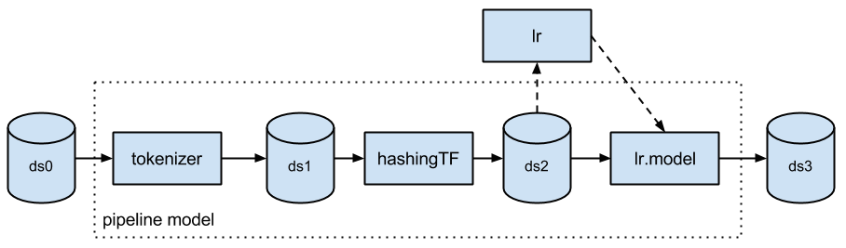
ML: Python Example
from from from
pyspark.ml import Pipeline
pyspark.ml.classification import LogisticRegression pyspark.ml.feature import HashingTF, Tokenizer
tokenizer | = | Tokenizer(inputCol="text", outputCol="words")
hashingTF | = | HashingTF(inputCol="words", outputCol="features")
lr | = | LogisticRegression(maxIter=10, regParam=0.01)
pipeline | = | Pipeline(stages=[tokenizer, hashingTF, lr])
df = context.load("/path/to/data") model = pipeline.fit(df)
143

Slide 110


ML: Scala Example
import import import
org.apache.spark.ml.Pipeline org.apache.spark.ml.feature.{HashingTF, Tokenizer} org.apache.spark.ml.classification.LogisticRegression
val tokenizer = new Tokenizer(). setInputCol("text"). setOutputCol("words")
val hashingTF = new HashingTF(). setNumFeatures(1000). setInputCol(tokenizer.getOutputCol). setOutputCol("features")
val lr = new LogisticRegression().
setMaxIter(10). setRegParam(0.01)
val pipeline = new Pipeline().setStages(Array(tokenizer,
hashingTF,
lr))
val df val
= sqlContext.load("/path/to/data")
model = pipeline.fit(df)
1
44

Slide 111
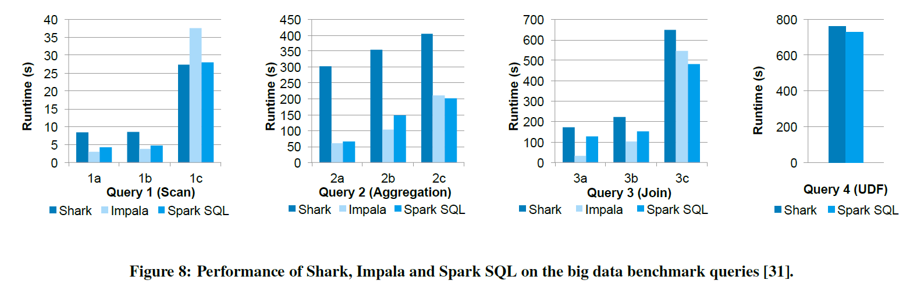
SQL Performance
Notes:
Most selective to least selective.
Impala choose a smarter join plan

Slide 112
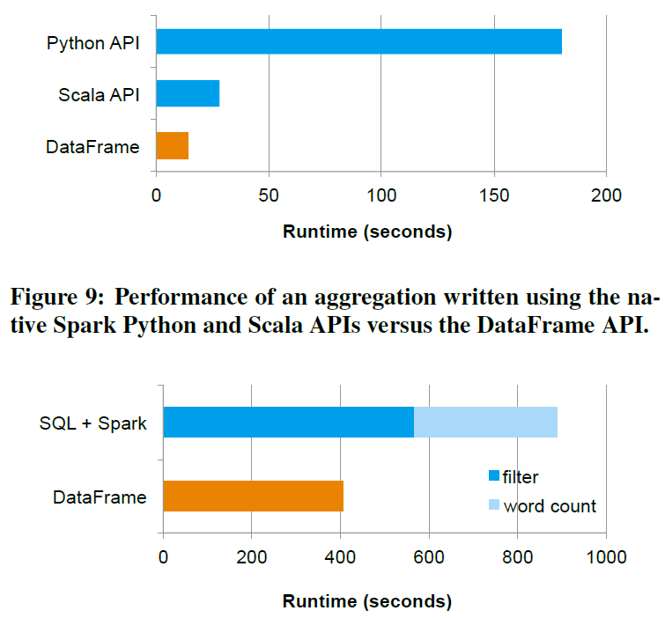
Notes:
logical plan is constructed in Python, and all physical execution is compiled down into native Spark code as JVM bytecode
the code in the DataFrame version avoids expensive allocation of key-value pairs that occurs in hand-written Scala code.
avoids the cost of saving the whole result of the SQL query to an HDFS

Slide 113
Conclusion
Extends Spark with a declarative DataFrame API to allow relational processing, offering benefits such as automatic optimization, and letting users write complex pipelines that mix relational and complex analytics.
Supports a wide range of features tailored to large-scale data analysis, including semi-structured data, query federation, and data types for machine learning.

